Slide 1
INTRODUCTION TO AZURE AD
DERRICK KLECKNER, SENIOR SYSTEMS ENGINEER

Slide 2
WHAT WE DO
IDENTITY & ACCESS MANAGEMENT
CYBERSECURITY
CLOUD SERVICES
SALES, SERVICES, AND SUPPORT

Slide 3

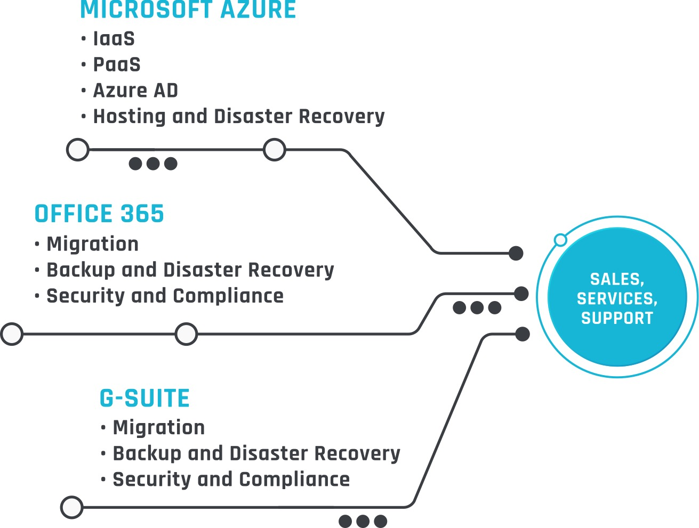
CLOUD SERVICES DYNAMIC AND SCALABLE SERVICES AND RESOURCES
Consulting and Support
Migrations
Identity as a Service
Security and Compliance
Hosting
Backup and Disaster Recovery

Slide 4
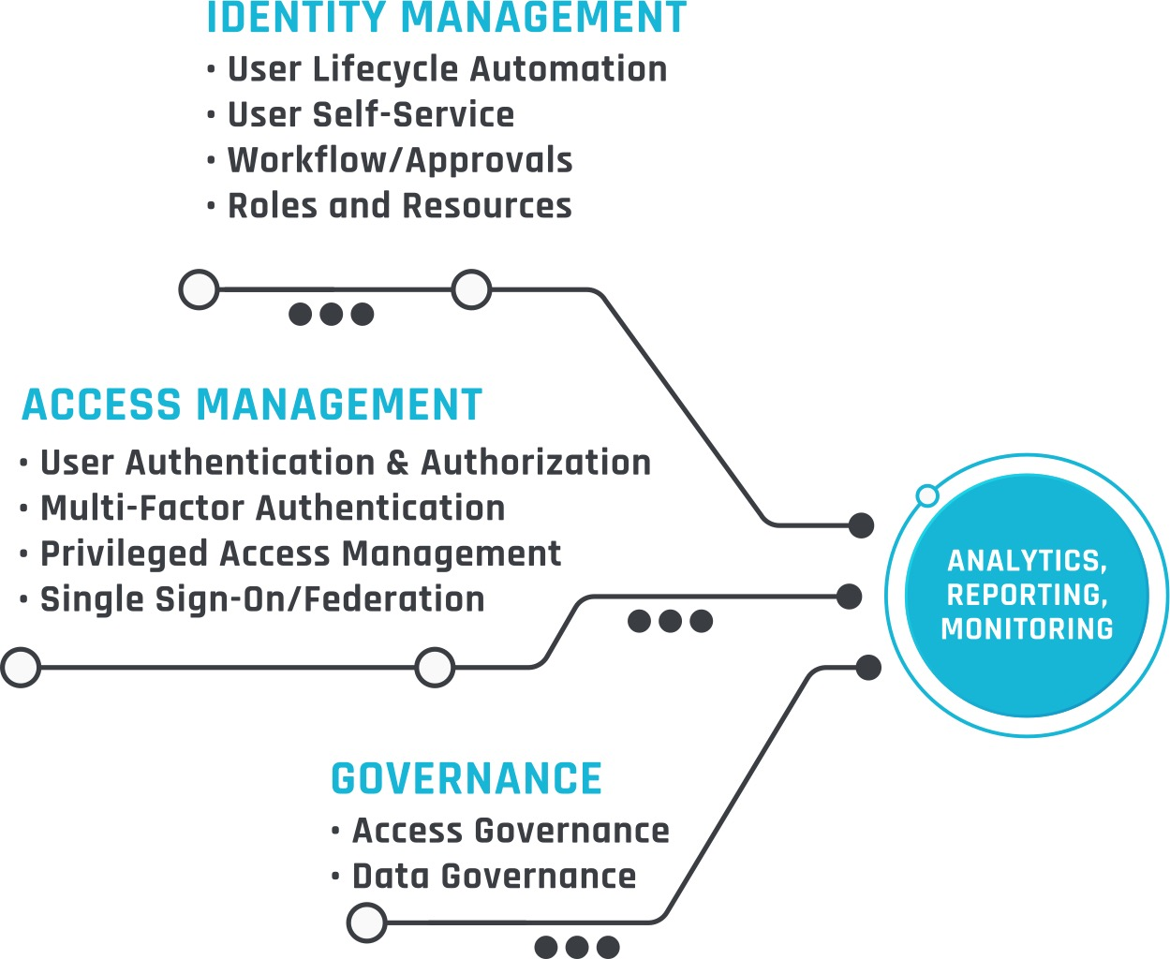
IDENTITY AND ACCESS MANAGEMENT IDENTITY POWERED SECURITY
Top Tier Partnerships with Multiple Vendors
Expert Level Architects and Engineers
Experience in many verticals
Strategy, Roadmaps, Product Selection, Architecture and Design

Slide 5
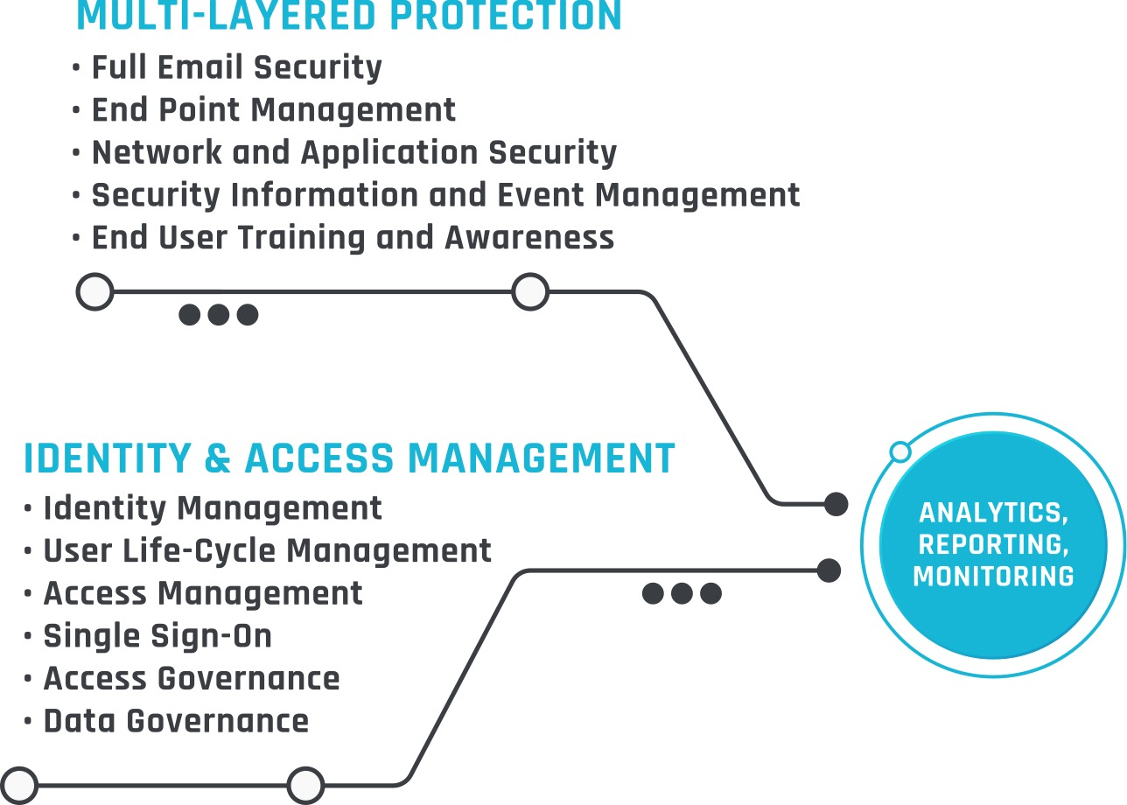
CYBERSECURITY BALANCE USER CONVENIENCE WITH REDUCED ORGANIZATIONAL RISK
Multi-Layered approach for small business to large enterprise
Top Tier Partnerships with Multiple Vendors
Identity Centered Approach

Slide 6
TODAYS TOPICS – Azure AD Premium
What is Azure AD Premium (Azure Basic/P1/P2)
Why do I want Premium Features?
P1 – Features
P2 – Features
How do I implement some of the top features?
Demos

Slide 7
AZURE AD
“Azure Active Directory (Azure AD) is Microsoft’s cloud-based identity and access management service. Azure AD helps your employees sign in and access resources”

Slide 8
AZURE AD FEATURE COMPARISON
Feature | Free | Basic | P1 | P2
Object Limits | 500,000 | unlimited | unlimited | unlimited
User and Group Management/device registration | ✓ | ✓ | ✓ | ✓
Single Sign-On | limited | limited | No limit | No limit
On Premises Directory Sync (Azure AD Sync) | ✓ | ✓ | ✓ | ✓
Group-Based Access Management/Provisioning |  | ✓ | ✓ | ✓
Self-service password reset (cloud only) |  | ✓ | ✓ | ✓
Company Branding |  | ✓ | ✓ | ✓
Application Proxy |  | ✓ | ✓ | ✓
Multi-Factor Authentication |  |  | ✓ | ✓
Advanced/Dynamic Groups |  |  | ✓ | ✓
Write Back (SSPR/Objects) |  |  | ✓ | ✓
Microsoft Identity Manager |  |  | ✓ | ✓
Risked Based Conditional Access |  |  |  | ✓
Privileged Identity Management |  |  |  | ✓
Notes:
https://azure.microsoft.com/en-us/pricing/details/active-directory/ for features list
https://docs.microsoft.com/en-us/azure/active-directory/fundamentals/active-directory-whatis for good info on Basic/P1/P2

Slide 9
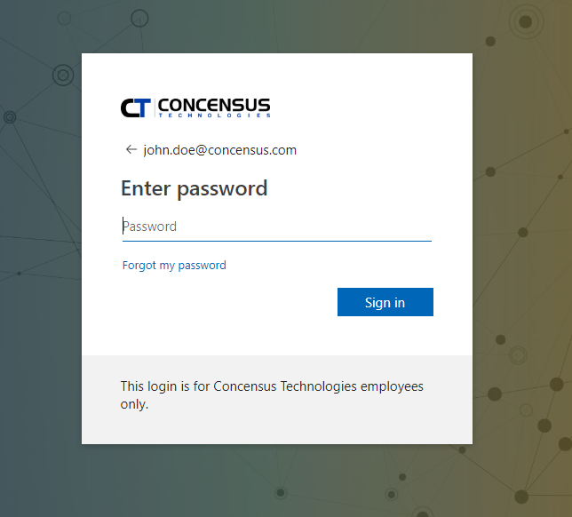
COMPANY BRANDING
Personalize your organization login screen helps prevent phishing attacks
Your Logo and Colors

Slide 10
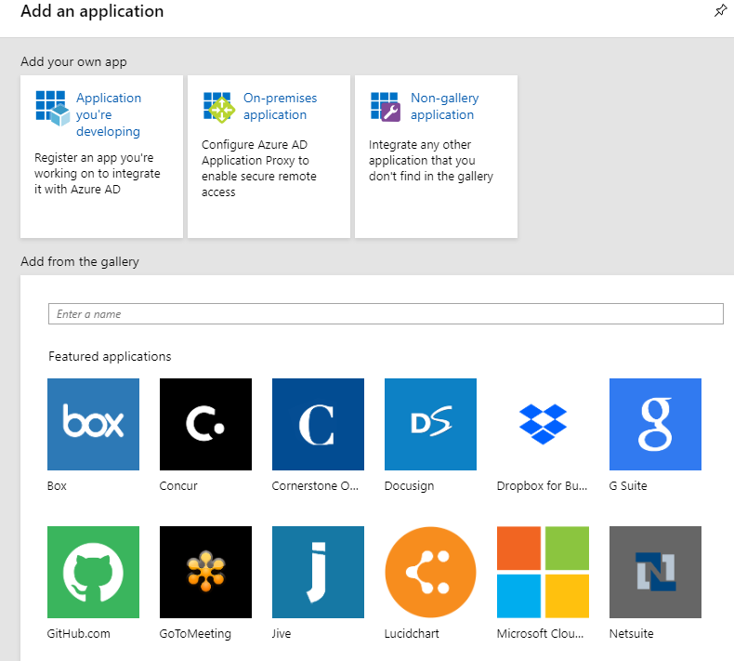
GROUP BASED MANAGEMENT
Assign Licenses via Dynamic Groups
Provisioning to Applications from the AZURE APP Store

Slide 11
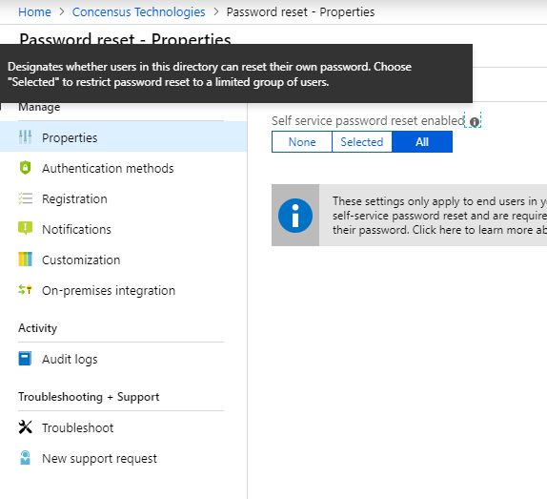
SELF-SERVICE PASSWORD RESET
Authentication Methods
Registration
In Action
Write Back

Slide 12
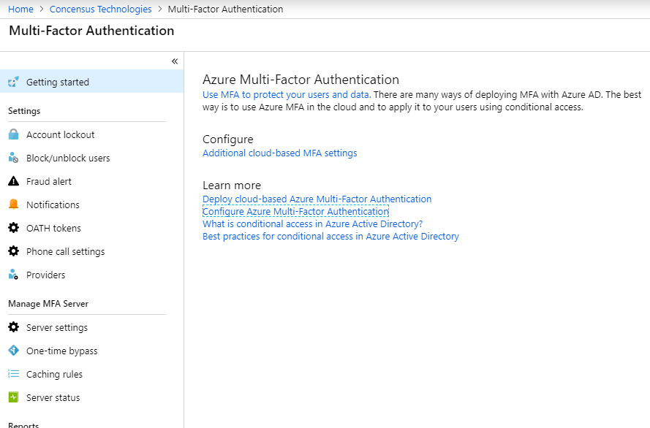
MULTI-FACTOR AUTHENTICATION
Cloud based MFA
3rd Party MFA

Slide 13
THANK YOU
QUESTIONS
Derrick.Kleckner@concensus.com
www.concensus.com/events

